Slide 1
The Institutional Compass
Environmental Data

Slide 2
The Plan Today
Choice of two regions to study as a class
General remarks about the compass
Wish spot on the compass
Environmental data – what is it?
Environmental data – how do we analyse it?

Slide 3
1. General Remarks
By “Institution” I mean a human system or organisation – a region, a company, a government, a university, a municipality, a household...
It has a boundary/identity, rules, purpose and a context/milieu.
Institutions influence our behaviour both as members, users or as finding ourselves in the same context.
We also influence institutions.

Slide 4
1. General remarks: Purpose
A compass is meant to give the institution a sense of direction. In our case the direction is a quality-direction of the institution.
For any insitution, there are two compasses: a “wish” compass and an actual compass - based on facts.

Slide 5
1. General remarks: Purpose
An institutional compass can be used for: policy decisions or critique of policy, to justify policy or communicate policy. It can be used to include more people in the policy making process - making the institution more democratic.
It can be used to compare between: the same insitution at different times, similar institutions and even quite dis-similar institutions.
Adaptations of the institutional compass can be used to evaluate, serve as an non-linear accouting devise, and therefore, as an economic conception that goes beyond monetary values.

Slide 6
1. General remarks: The three Qualities

Slide 7
2. The Wish compass: Identifying a wish spot

Slide 8
2. The Wish Spot and the Actual Compass: An institutional compass indicates the direction of an institution in terms of the three general qualities.
Notes:
Explain “Institution”.
Explain the qualities.

Slide 9
2. An institutional compass indicates the direction of an institution in terms of the three general qualities.
The arrow of the actual compass is mathematically calculated from a number of data points which are each analysed as a « data arrow ».
Soon we shall discuss the collection and analysis of data points and the mathematics for the measurement. But first let us jump to the end of the story.
We compare the actual compass to the wish spot.

Slide 10
2. An institutional compass indicates the direction of an institution in terms of the three general qualities.
If the arrow is not pointing in the wish spot, then we look back at the data. Since each data point can be represented as an arrow in its own right, we can ask: which arrows (data points) point away from the wish spot, and which arrows point towards? For policy, choose some that you can influence under a negotiated time-frame.
« Influence » means make longer or shorter, or rotate.
Claim: If enough institutions commit to influencing key data points and carry out the influence within the negotiated timeframe, then the actual arrow will approach the wish spot – provided the context does not change too much.

Slide 11
2. The actual arrow moves through policy and action.
Notes:
Explain “Institution”.
Explain the qualities.

Slide 12
3. Environmental Data, What is it?
We’re going to collect 3 general types of data for our regions: environmental, economic and social. We start with environmental.

Slide 13
3. Environmental data – what is it?
“Non-living” part of the environment:
Air quality indicators
Water quality indicators
Soil quality indicators
Entropic change

Slide 14
3. Environmental data – what is it?
Living part of the environment:
“regular species mix”: roughly what is the density of: trees bushes, grasslands, water ecosystems; insects, worms… birds, rodents, reptiles, mammals…
“Indicator species”: sensitive to changes in the environment – monitor their population density, and adaptive changes – eg. Smaller leaves on trees or bushes, shortened life-span...
“New species” invasive species are an indicator of ecosystem collapse - monitor their population density, and ask what role they play in the ecosystem.

Slide 15
4. Environmental data – how do we analyse it?
Accord each a length and a degree on the institutional compass circle – indicating a quality direction.
We need to be very careful here. We are analysing environmental data. We should analyse it scientifically – with respect to health of the ecosystem, not human preferences.
For example, air quality data is usually measured in terms of air quality for humans, not for birds or insects. Here we want air quality for insects. We have to ask biologists to help us.

Slide 16
4. Environmental data – how do we analyse it?
Length
Each data point is compared to a baseline – of what is “normal”. The latter is determined over time if you have done some indicator data collection over time, or across eco-systems that are similar (same mix of species in another location).
Score this on a scale of 0 – 10.
0 is non-existent.
5 is average for that ecosystem.
10 is extreme.

Slide 17
4. Environmental data – how do we analyse it?
Length
The length of each data point can be thought of as: where would you put it on the y-axis of a regular graph of the data?

Slide 18
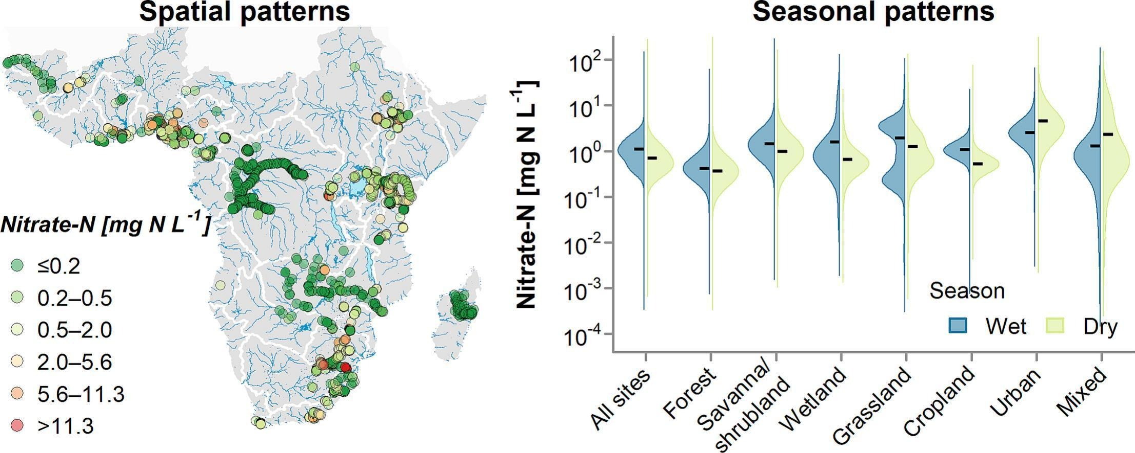
4. Environmental data – how do we analyse it?
Length
For example

Slide 19
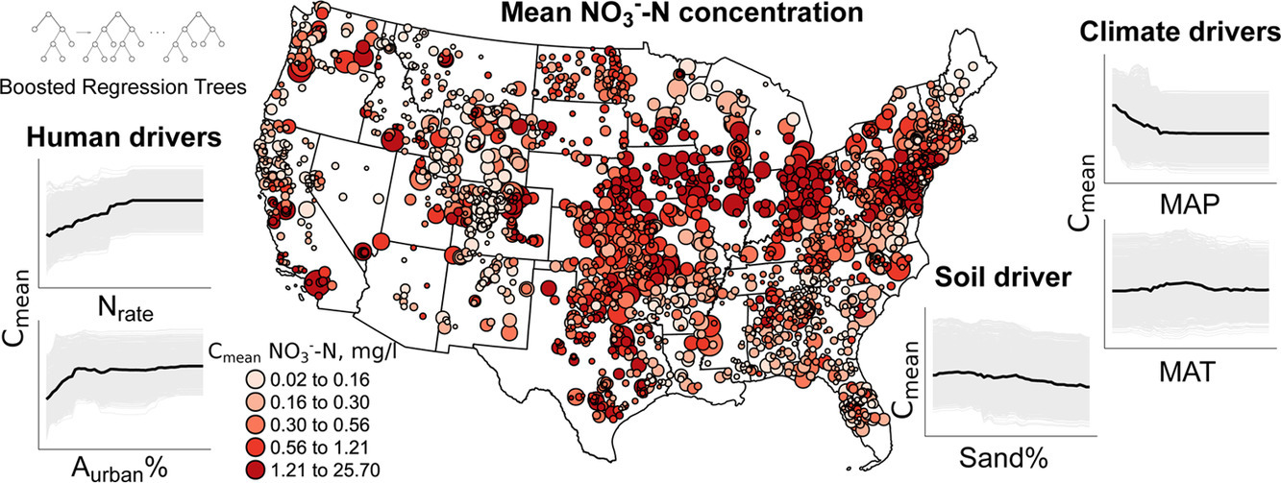
4. Environmental data – how do we analyse it?
Length
For example:

Slide 20
4. Environmental data – how do we analyse it?
Degrees: Harmony
Harmony for the environment means a healthy ecology – for that region : good/ normal bio-diversity, no changes in quality of non-living environment, no changes in biodiversity, no adaptive changes in existing species – over as long a time-span as ??? What is reasonable? We should decide this for our regions.

Slide 21
4. Environmental data – how do we analyse it?
Degrees: Harmony
With 0 as the degree between Excitement and Harmony, and 120 as the degree between Harmony and Discipline,

Slide 22
4. Environmental data – how do we analyse it?
Degrees: Harmony
Degrees within harmony but towards excitement are for changes and adaptations within the normal population. Such as 400 year cold cycles, or “normal” forest fire cycles, flooding cycles…
Degrees within harmony but towards discipline are for changes that threaten ecosystem collapse i.e., for the ecologists, alarm bells are going off: shrinking populations of indicator species… The ecosystem is being stressed, but could still recover.

Slide 23
4. Environmental data – how do we analyse it?
Degrees: Discipline 120 - 240
Decline in the density of: trees, bushes, grasses, insects, worms… birds, aquaculture, rodents, reptiles, mammals…
Local extinction or threat of extinction.
“New species” invasive species are an indicator of ecosystem collapse - monitor their population density, and ask what role they play in the ecosystem.

Slide 24
4. Environmental data – how do we analyse it?
Degrees: Discipline
Air quality indicators: poor air quality for the ecosystem.
Water quality indicators: poor water quality for the ecosystem.
Soil quality indicators: poor soil quality for the ecosystem.
Shrinking natural spaces, pollution, extreme drought, fires, heat…
Extraction of minerals: (mining activities, quarries).
Entropic change: More heat coming into the ecosystem than leaving.

Slide 25
4. Environmental data – how do we analyse it?
Degrees: Discipline
Degrees within discipline but towards harmony are for there-stabilizing of the ecosystems. Once stabilized, they might move to harmony (depending on the baseline. beginning of collapse – shrinking of a species beyond the point of recover (might be hard to guess). Or stresses to the ecosystem such as fires, drought, heat, extreme weather…
180 degrees are for (local) extinctions, loss of habitat – cementing over, building; noise, light, heat, fires, drought, extreme weather… and chemical pollution. Human waste. The arrow for this is short if it is well managed!
Degrees within discipline but towards excitement are for the new stresses to the ecosystem. Note: these measures are meant to be absolute – not relative to how much worse it would be if we were to do nothing.

Slide 26
4. Environmental data – how do we analyse it?
Degrees: Excitement
Excitement is about changes to the environment – so this is our imposition on the environment to improve it (for it’s sake, or for us). The more it is for us – the closer it is to discipline. The more it is for the sake of the environment the closer to harmony. Conservation measures are in excitement when they are new (because still disruptive and changing) as the conservation are/ measures become integrated into the more natural ecosystem, the arrow will rotate into harmony.

Slide 27
4. Environmental data – how do we analyse it?
Degrees: Excitement
The building of dams, dikes, draining of swamps, changing the course of a waterway, effects of high walls (under water or on land), solar farms, wind farms… - note: we are looking in absolute terms about how this changes the natural environment – not a relative effect. The birds don’t survive better in absolute numbers because it could have been worse. The bird population continues to decrease, just at a slower pace. The arrow lengthens more slowly. So, careful about the difference between length and degree. This is the tricky conceptual part of the analysis.

Slide 28
4. Environmental data – how do we analyse it?
Degrees: Excitement
Agriculture: The more organic, circular (self-fertilizing) and native, the closer to harmony. The more industrial (genetic manipulation, pesticides, herbicides, synthetic fertilisers, heavy tractors, mono-culture, large fields, irrigation) the closer to discipline.
Gardening: (length not significant if gardens do not use up a lot of land) the more biodiversity of native species, and the closer to the natural ecosystems, the more neglected (!) the closer to harmony; the more exotic species, invasive species, artificiality… the closer to discipline.

Slide 29
Homework: The Region you chose
Those of you assigned the technological fix essay bring in 2 data points that are for the environment that are in excitement in your region.
Those of you assigned the cultural fix essay bring in 3 data points for the environment that are in harmony in your region.
Those of you assigned the economic fix essay bring in 3 data points for the environment that are in discipline in your region.
For each of your data points assign it a degree and a length. As a baseline for the length take the surrounding regions… Justify your assignment of degree and length.

Slide 30
Homework: The Region you chose
Data tables include 7 columns:
(1) Number of data point, (2) name of data point, (3) source of data (web page address), (4) basis of comparison (what were you comparing the data to? Are you using a second website?), (5) remarks: hesitations, unclarities, questions…. (6) length, (7) degree.

Slide 31
Homework: The Region you chose
For those of you trying option 2 for the economic fix essay, try out the compass app. modules 1, 2, 3 for your environmental data points. Note that your “full” data set will have economic and social data as well, so the environmental data should only include about 5 data points.
The information and link is in the electronic reserves on blackboard.

